Slide 1
Lecture 8: Estimating geometry
Slides mostly from N. Snavely
Notes:
Finish up discussion of multi-view geometry
talk about how you can estimate the 3d structure and camera geometry of a scene if you have a bunch of photos from it

Slide 2
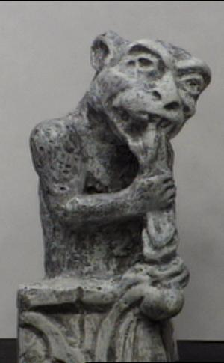
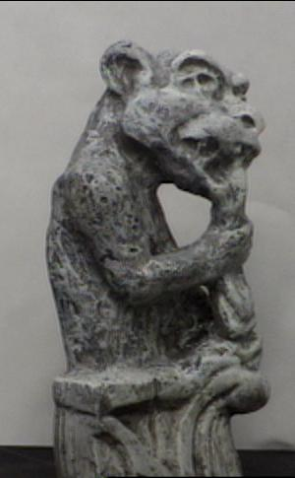
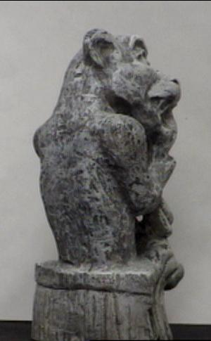
Recall: triangulation
Given projection p_{i} of unknown 3D point X in two or more images (with known cameras P_{i}), find X
Source: D. Fouhey

Slide 3
Triangulation
Given projection p_{i} of unknown 3D point X in two or more images (with known cameras P_{i}), find X
Why is the calibration here important?
X?
p₁
p₂
Source: D. Fouhey

Slide 4
Triangulation
Rays in principle should intersect, but in practice usually don’t exactly due to noise, numerical errors.
X?
p₁
p₂
Source: D. Fouhey

Slide 5
Triangulation – Geometry
Find shortest segment between viewing rays, set X to be the midpoint of the segment.
X
p₁
p₂
Source: D. Fouhey

Slide 6
Triangulation – Geometry
Find shortest segment between viewing rays, set X to be the midpoint of the segment.
X
p₁
p₂
Source: D. Fouhey

Slide 7

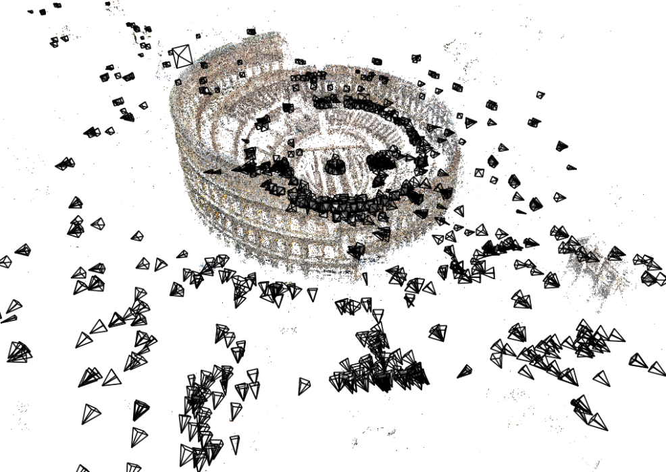
Estimating 3D structure
Given many images, how can we…
  Figure out where they were all taken from?
  Build a 3D model of the scene?
  This is the structure from motion problem
Source: N. Snavely
Notes:
Want to get a 3D model from photos.
Given a set of photos, estimate the 3d geometry of the objects in a scene and the pose of all the cameras

Slide 8
Today
Structure from motion
Multi-view stereo
Visual SLAM

Slide 9
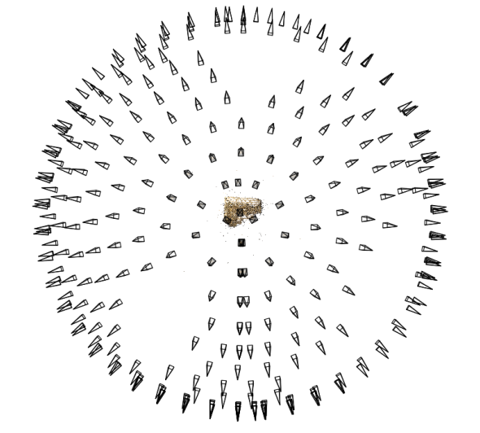
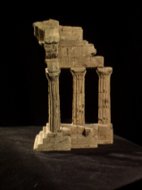
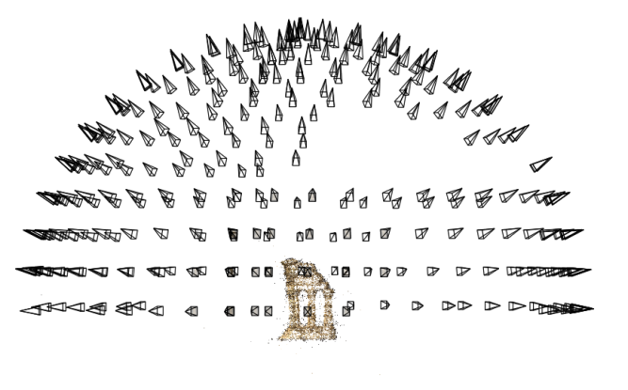
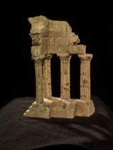
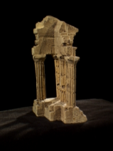
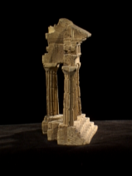
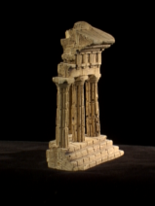
Structure from motion
Reconstruction (side)
(top)
Input: images with pixels in correspondence p_{i,j} = (u_{i,j},v_{i,j})
Output
  Structure: 3D location x_{i} for each point p_{i}
  Motion: camera parameters R_{j} , t_{j} possibly K_{j}
Objective function: minimize reprojection error
Source: N. Snavely
Notes:
Input similar to panorama stitching problem.

Slide 10
Camera calibration & triangulation
Suppose we know 3D points
  And have matches between these points and an image
  Computing camera parameters similar to homography estimation
Suppose we have know camera parameters, each of which observes a point
  We can solve for the 3D location
Seems like a chicken-and-egg problem, but in SfM we can solve both at once
Source: N. Snavely
Notes:
Show x = P X
turns out the best way to solve these things is to do them both at once

Slide 11
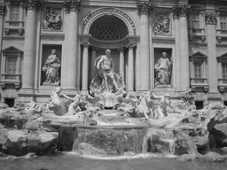


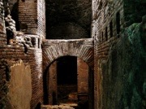

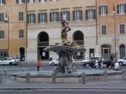

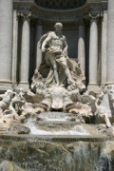


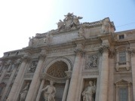



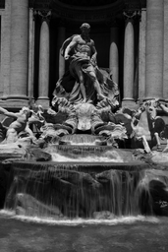

Feature detection
Same process as with homography estimation
Detect features using SIFT
Source: N. Snavely
Notes:
So, we begin by detecting SIFT features in each photo.
[We detect SIFT features in each photo, resulting in a set of feature locations and 128-byte feature descriptors…]

Slide 12

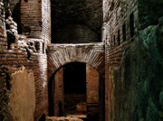


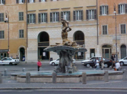




Feature matching
Match features between each pair of images
Source: N. Snavely
Notes:
Next, we match features across each pair of photos using approximate nearest neighbor matching.

Slide 13


Feature matching
Remove bad matches using ratio test.
Other tricks: throw out matches that aren’t on epipolar lines.
Source: N. Snavely
Notes:
The matches are refined by using RANSAC, which is a robust model-fitting technique, to estimate a fundamental matrix between each pair of matching images and keeping only matches consistent with that fundamental matrix.
We then link connected components of pairwise feature matches together to form correspondences across multiple images.
Once we have correspondences, we run structure from motion to recover the camera and scene geometry. Structure from motion solves the following problem:

Slide 14
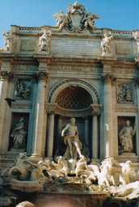
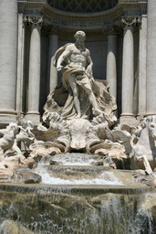
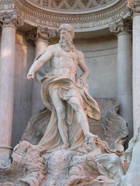
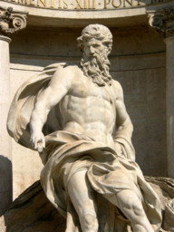
Correspondence estimation
Track each feature across the dataset.
Link up pairwise matches to form connected components of matches across several images.
Image 1
Image 2
Image 3
Image 4
Source: N. Snavely
Notes:
The next step of our reconstruction algorithm is to link up matches between pairs of images into correspondences between multiple images, by finding connected components of matches. Suppose among these images, these features are matched only between consecutive pairs of images, perhaps because the scales of the images are so different. During correspondence estimation we link these matches and consider them to be 2D projections of a single 3D point in the scene.

Slide 15
Correspondence estimation
A point track: the same 3D point projects to all 4 image positions.
Image 1
Image 2
Image 3
Image 4
Notes:
The next step of our reconstruction algorithm is to link up matches between pairs of images into correspondences between multiple images, by finding connected components of matches. Suppose among these images, these features are matched only between consecutive pairs of images, perhaps because the scales of the images are so different. During correspondence estimation we link these matches and consider them to be 2D projections of a single 3D point in the scene.

Slide 16
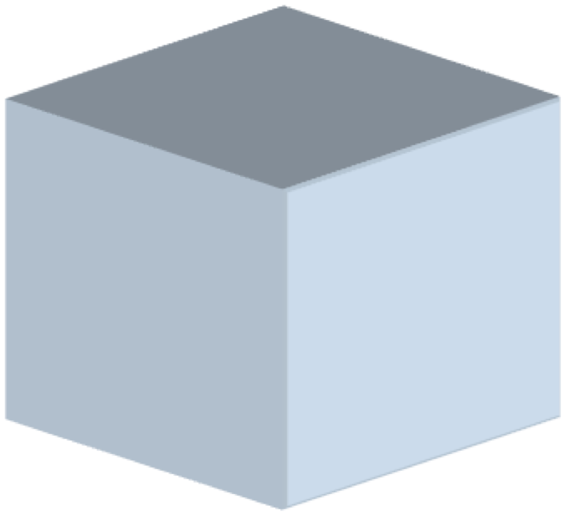
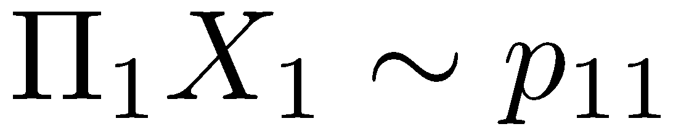
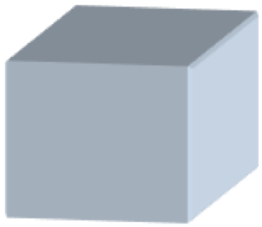

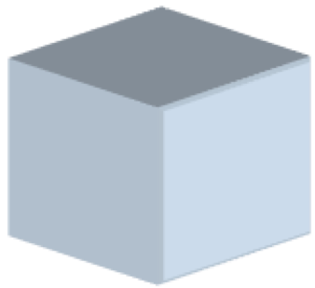
Structure from motion
X₄
X₁
X₃
X₂
X₅
X₇
X₆
p_{1,1}
p_{1,3}
p_{1,2}
Camera 1
Camera 3
R₁,t₁
R₃,t₃
Camera 2
R₂,t₂
Source: N. Snavely
Notes:
Structure from motion solves the following problem:
Given a set of images of a static scene with 2D points in correspondence, shown here as color-coded points, find…
a set of 3D points and also the camera pose
Measure quality of results: a rotation R and position t of the cameras that explain the observed correspondences. In other words, when we project a point into any of the cameras, the reprojection error between the projected and observed 2D points is low.
This problem can be formulated as an optimization problem where we want to find the rotations R, positions t, and 3D point locations P that minimize sum of squared reprojection errors f.
This is a non-linear least squares problem and can be solved with algorithms such as Levenberg-Marquart. However, because the problem is non-linear, it can be susceptible to local minima. Therefore, it’s important to initialize the parameters of the system carefully. In addition, we need to be able to deal with erroneous correspondences.

Slide 17
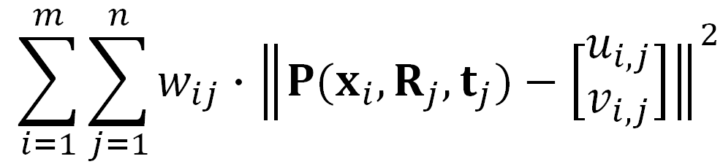

Structure from motion
Minimize sum of squared reprojection errors:
Minimizing this function is called bundle adjustment.
  Optimized using non-linear least squares
Lots of outliers: use robust loss functions (e.g., Huber) and solve incrementally
predicted
image location
observed
image location
indicator variable:
is point i visible in image j ?
Source: N. Snavely
Notes:
bundle of light rays

Slide 18


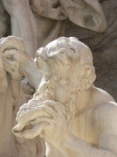


Incremental structure from motion
Source: N. Snavely
Notes:
To help get good initializations for all of the parameters of the system, we reconstruct the scene incrementally, starting from two photographs and the points they observe.

Slide 19
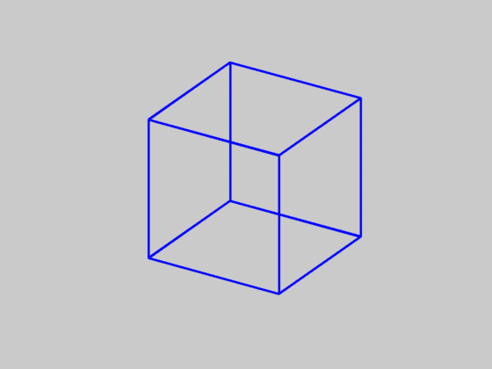
Is SfM always uniquely solvable?
No. Consider the Necker cube:
Source: N. Snavely

Slide 20
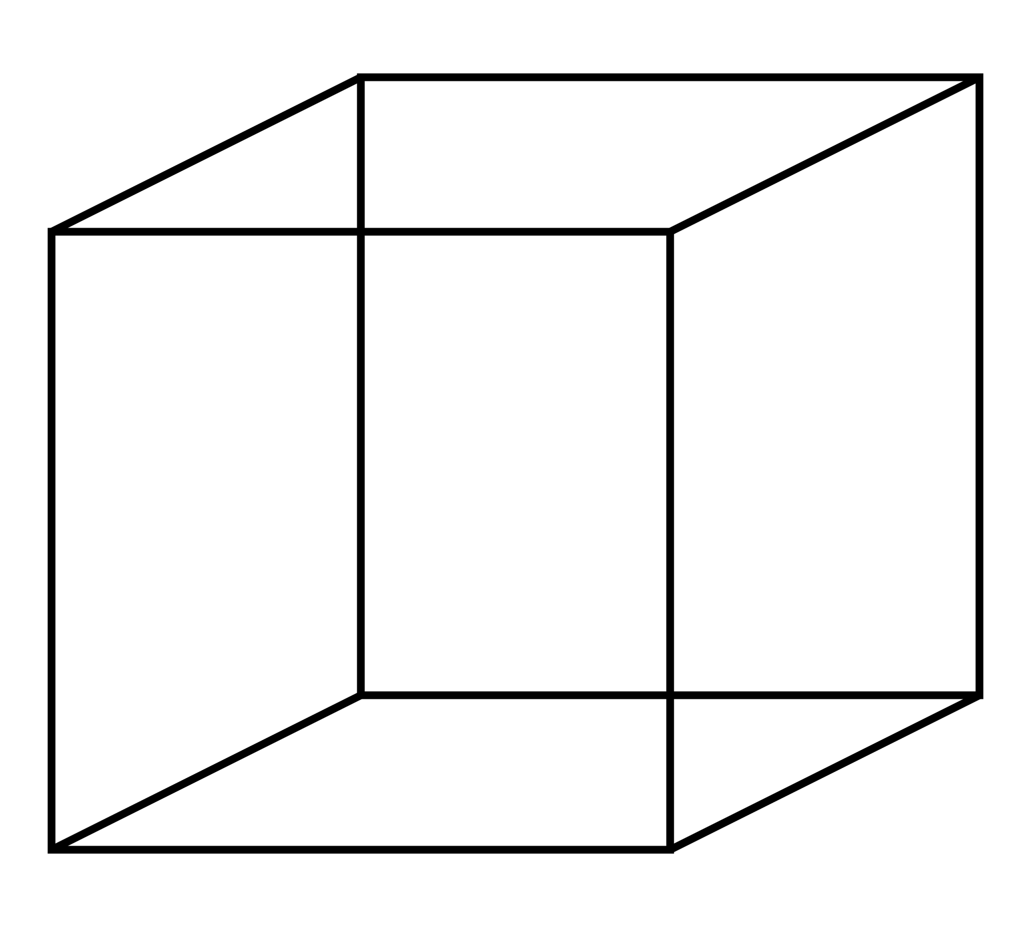
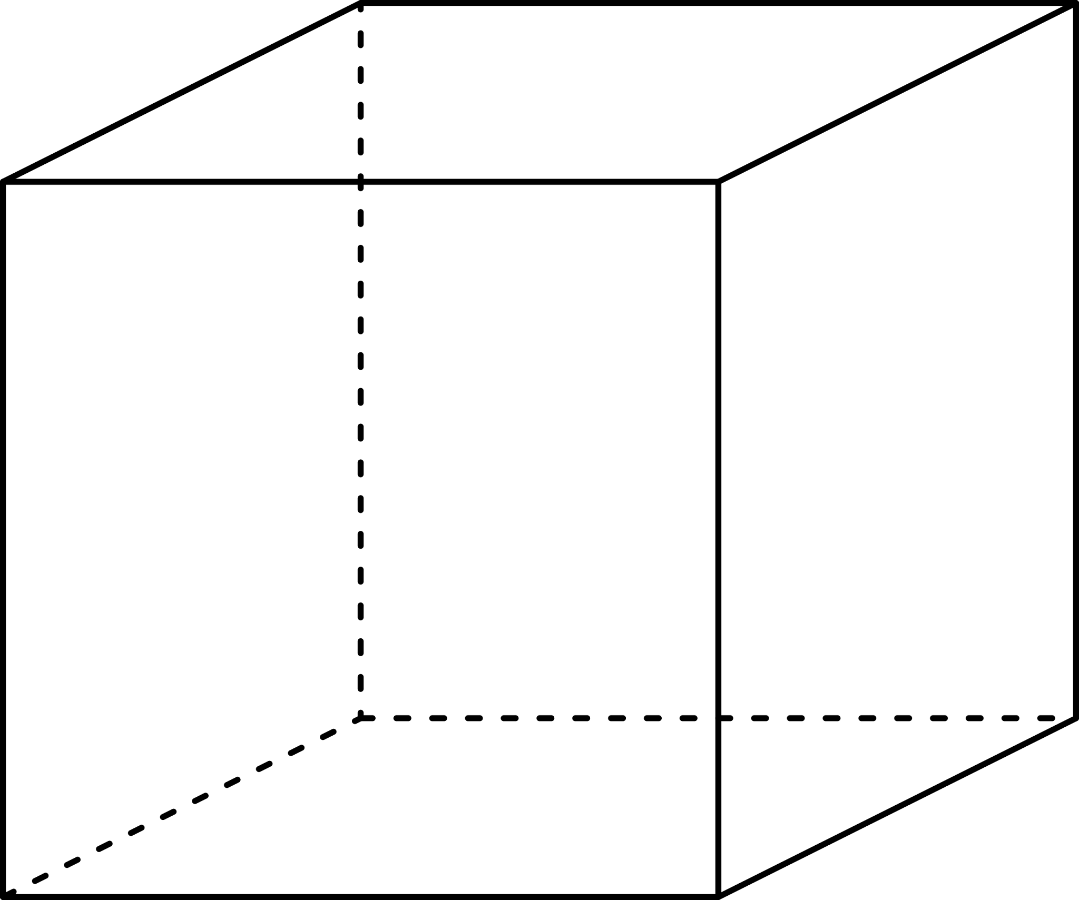
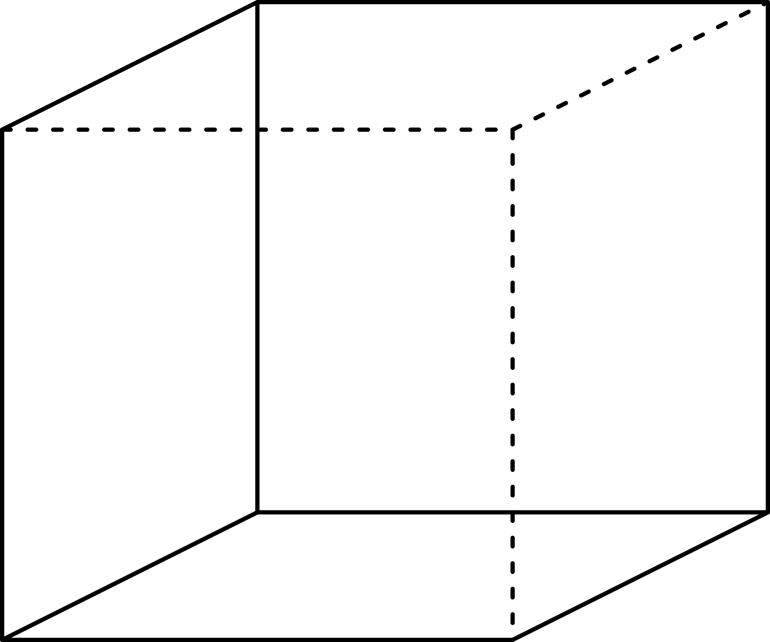
Is SfM always uniquely solvable?
Two interpretations:
Image source: Wikipedia

Slide 21
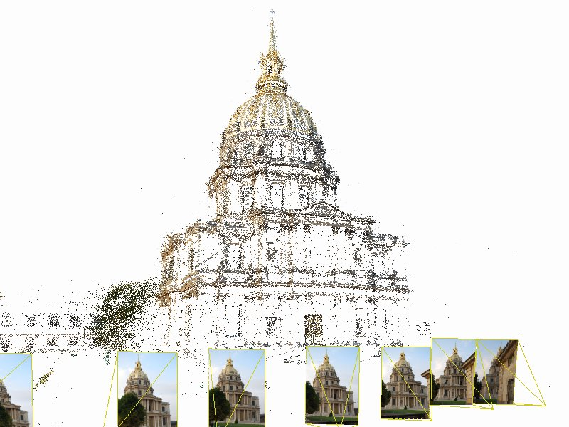
Can also reconstruct from video
Source: N. Snavely

Slide 22
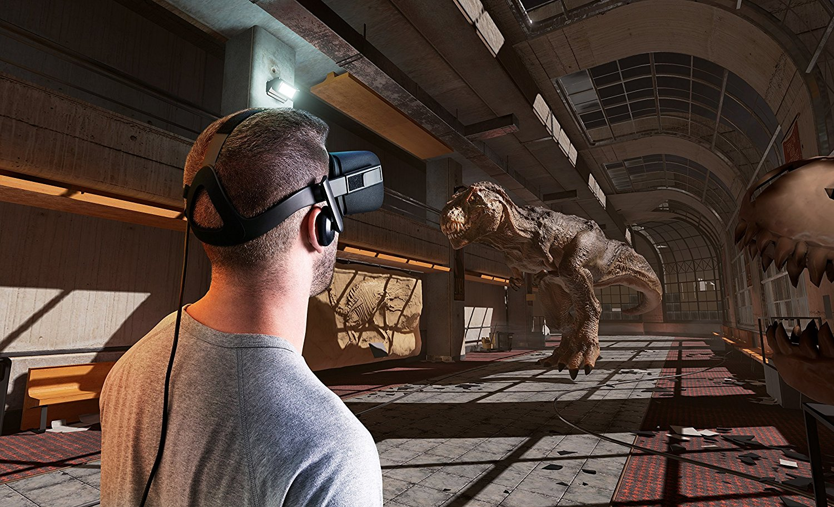

Applications: Visual Reality & Augmented Reality
Oculus
Hololens
https://www.youtube.com/watch?v=KOG7yTz1iTA
https://www.youtube.com/watch?v=FMtvrTGnP04
Source: N. Snavely

Slide 23
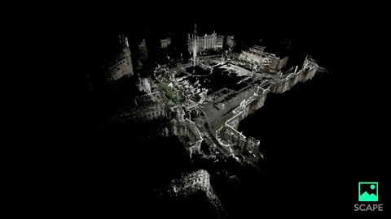
Application: Simultaneous localization and mapping (SLAM)
Scape: Building the ‘AR Cloud’: Part Three —3D Maps, the Digital Scaffolding of the 21st Century
https://medium.com/scape-technologies/building-the-ar-cloud-part-three-3d-maps-the-digital-scaffolding-of-the-21st-century-465fa55782dd
Source: N. Snavely

Slide 24
Today
Structure from motion
Multi-view stereo
Stereo matching algorithms

Slide 25
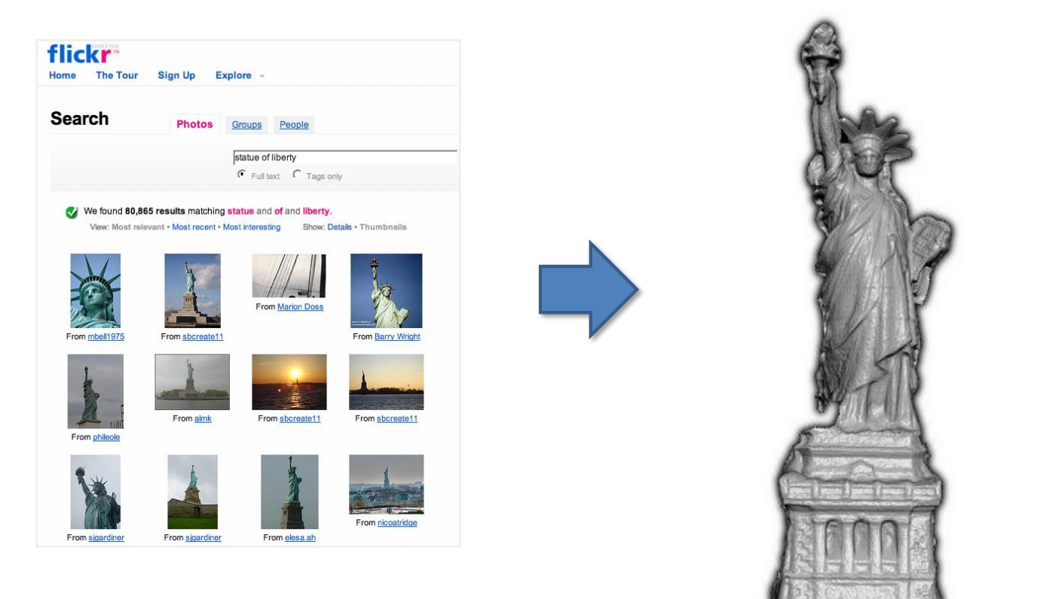
Multi-view stereo
Can we estimate depth, now that we have pose?
Source: N. Snavely

Slide 26
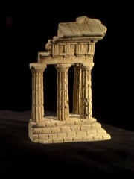
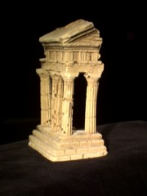

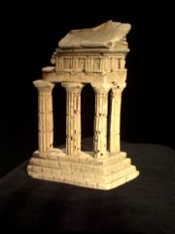
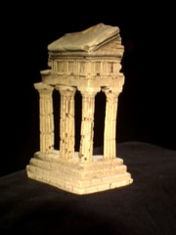

Multi-view stereo
Is this a surface point?
reference view
neighbor views
Source: Y. Furukawa
Notes:
So the basic idea of Multiview stereo starts with
*a single reference view of the scene
*And some number of neighboring views
*Now, much like with regular stereo, we’re going to tackle the problem by trying to figure out the depth of each pixel in our reference image
*which we can do by sampling depths along the ray corresponding to each reference PIXEL
*So for each depth we sample, we can project the corresponding point into the other images and if the corresponding patches look like they image the same part of the scene

Slide 27
Multi-view stereo
Evaluate the likelihood of a particular depth for a particular reference patch:
Corresponding patches at depth guess in other views
?
Patch from reference View
reference view
neighbor views
Source: Y. Furukawa
Notes:
So, again, we’re evaluating the likelihood of a particular depth based on this idea that
IF THERE REALLY IS visible surface geometry at that depth, then these patches should look like the corresponding one in our reference view
And we can use something like sum of squared differences to measure error according to that similarity

Slide 28
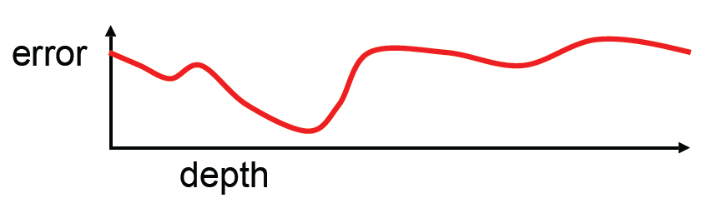
Multi-view stereo
Photometric error across different depths
reference view
neighbor views
Source: Y. Furukawa
Notes:
So now for each reference pixel we have different error values across different guesses for the corresponding depth

Slide 29
Multi-view stereo
Photometric error across different depths
reference view
neighbor views
Source: Y. Furukawa
Notes:
And we can search along

Slide 30
Multi-view stereo
Photometric error across different depths
Solve for a depth map over the whole reference view
reference view
neighbor views
Source: Y. Furukawa
Notes:
Until we find some convincing minimum for this error
*and if we do this for every pixel in the reference image then we get a depth map

Slide 31
Multi-view stereo: advantages
Can match windows using more than 1 neighbor, giving a stronger match signal
If you have lots of potential neighbors, can choose the best subset of neighbors to match per reference image
Can reconstruct a depth map for each reference frame, and the merge into a complete 3D model
Source: N. Snavely
Notes:
So why is Multiview stereo better than regular 2-image stereo?
*well, you have multiple neighbors with which to compare, which tends to make results more robust to things like noise or occlusion
*and if you have lots of neighbors, some may be more useful than others, but you at least have the ability to choose some best subset to use.
*and each image can be a reference frame, which you can combine later to get a more complete 3D model

Slide 32
Choosing the stereo baseline
all of these
points project
to the same
pair of pixels
width of
a pixel
Large Baseline
Small Baseline
What’s the optimal baseline?
  Too small: large depth error
  Too large: difficult search problem
Notes:
Now one thing that has a pretty big effect on your results is the size of the baseline between your cameras.
*if it’s too small, then you end up with poor depth resolution. Intuitively, you can think of the limit of this being no baseline at all, which means you have just one image, and each pixel could be at any depth.
*and if the baseline is too large then it means that a point in one image could appear in a lot of different places in the other image, which can turn into a hard search problem

Slide 33


Multiple-baseline stereo
z
width of
a pixel
pixel matching score
For short baselines, estimated depth will be less precise due to narrow triangulation
width of
a pixel
z
For larger baselines, must search larger area in second image
M. Okutomi and T. Kanade, “A Multiple-Baseline Stereo System,” IEEE Trans. on Pattern Analysis and Machine Intelligence.
Source: N. Snavely
Notes:
d=BF*1/Z, where B and F are baseline and focal length, respectively.
D: disparity, Z: depth
This equation indicates that for the same depth, the disparity is proportional to the baseline or that the baseline length B acts as a magnification factor in measuring d in order to obtain z, that is, the estimated depth is more precise if we set the two cameras farther apart from each other, which means a longer baseline. A longer baseline, however, poses its own problem. Because a longer disparity range must be searched, matching is more difficult, and thus, there is a greater possibility of a false match. Therefore, there is a tradeoff between precision and accuracy (correctness) in matching.

Slide 34
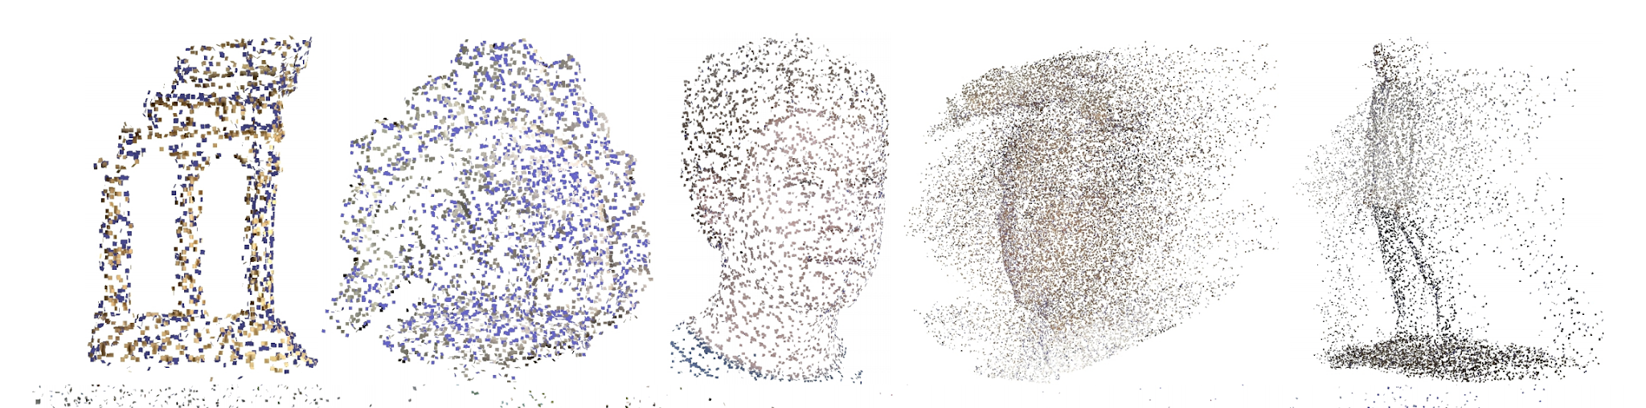
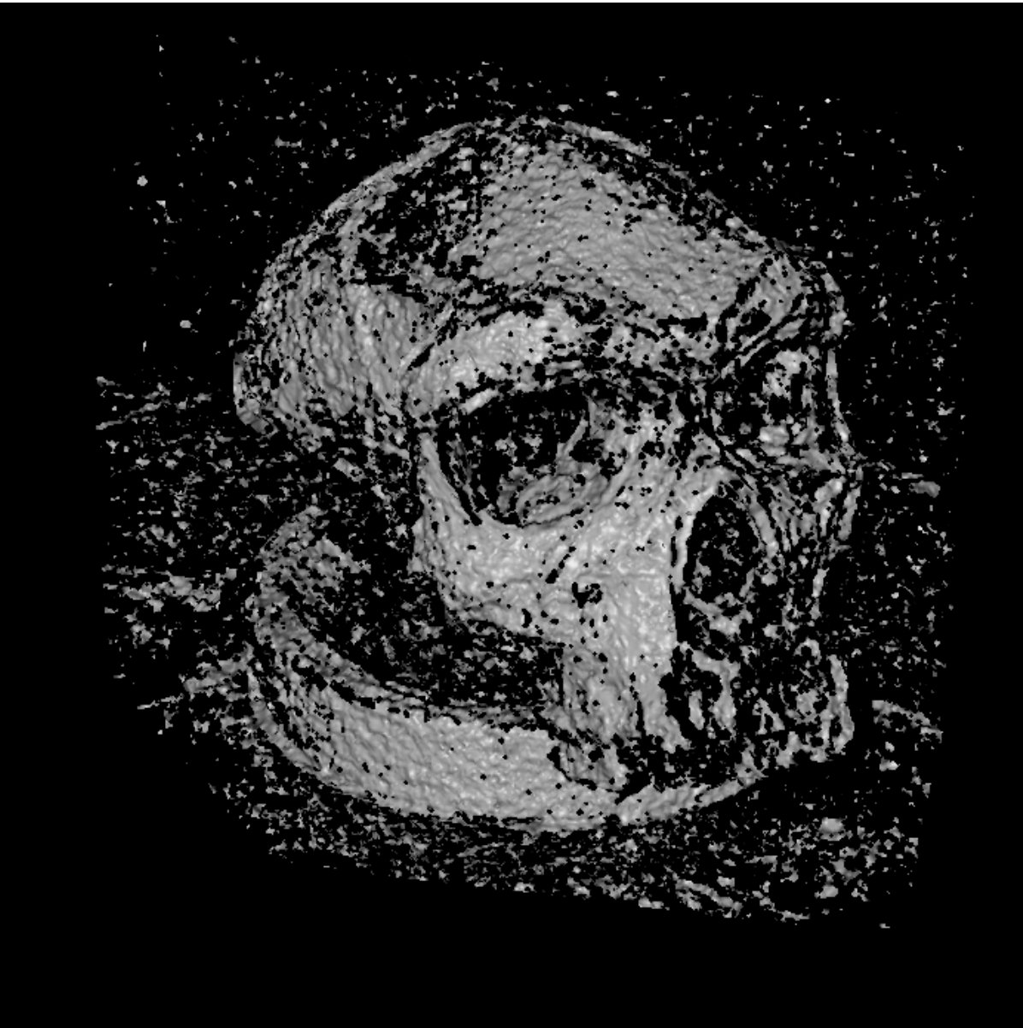
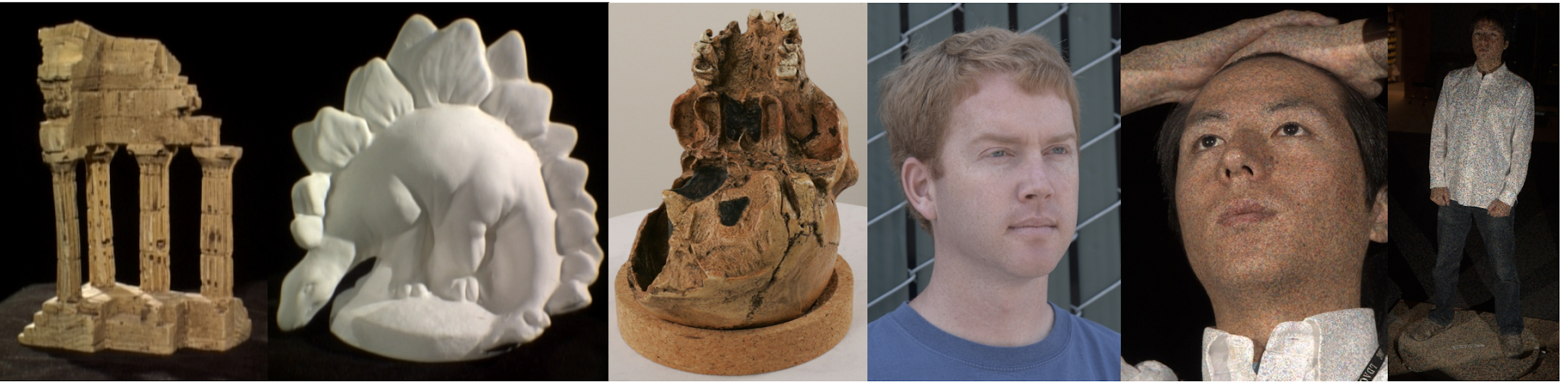
Depth is ambiguous from local information alone!

Slide 35
Today
Structure from motion
Multi-view stereo
Visual SLAM

Slide 36
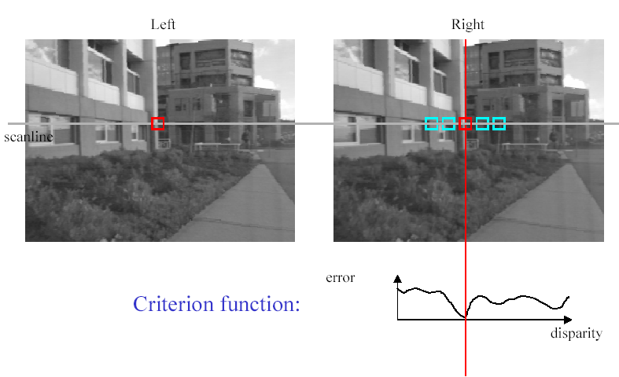
Recall: Stereo matching based on sum-of-squared distance
SSD
^{d}min d
Best matching disparity
Source: N. Snavely

Slide 37
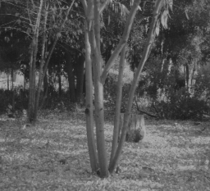
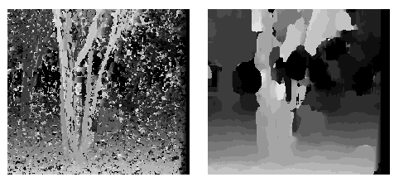
Window size
W = 3
W = 20
Source: N. Snavely
Notes:
smaller window: more detail, more noise
bigger window: less noise, more detail
Can anyone think of ways to deal with this?

Slide 38
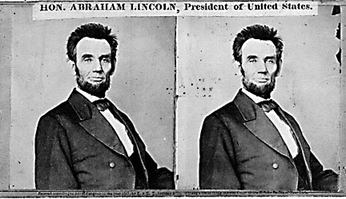
Stereo as energy minimization
What defines a good stereo correspondence?
  Match quality
    Want each pixel to find a good match in the other image
  Smoothness
    If two pixels are adjacent, they should (usually) move about the same amount
Source: N. Snavely
Notes:
Simultaneously captures smoothness and respects leads to good quality

Slide 39

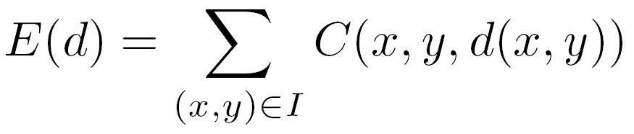

Stereo as energy minimization
Find disparity map d that minimizes an energy function , where d is disparity.
Simple pixel / window matching
Squared distance between windows I(x, y) and J(x + d(x,y), y)
Source: N. Snavely
Notes:
Think of this as an energy minimization

Slide 40



Stereo as energy minimization
y = 141
d
x
Simple pixel / window matching: choose the minimum of each pixel independently
Source: N. Snavely

Slide 41

Greedy selection of best match
Source: N. Snavely

Slide 42

Stereo as energy minimization
Better objective function
{
{
match cost
smoothness cost
    Want each pixel to find a good match in the other image
    Adjacent pixels should (usually) move about the same amount
Source: N. Snavely

Slide 43



Stereo as energy minimization
match cost:
smoothness cost:
: set of neighboring pixels
4-connected neighborhood
8-connected neighborhood
Source: N. Snavely

Slide 44


Smoothness cost
How do we choose V?
L₁ distance
“Potts model”
Source: N. Snavely

Slide 45

Dynamic programming
Can minimize this independently per row scanline using dynamic programming (DP)
Basic idea: incrementally build a table of costs D one column at a time
: minimum cost of solution such that d(x,y) = i
Base case:
(L = max disparity)
Recurrence:
Source: N. Snavely

Slide 46
Dynamic programming
y = 141
d
x
Finds “smooth”, low-cost path through cost volume from left to right
Source: N. Snavely

Slide 47



Dynamic programming
Source: N. Snavely

Slide 48

Dynamic programming
Can we apply this trick in 2D as well?
No: d_{x,y-1} and d_{x-1,y} may depend on different values of d_{x-1,y-1}
Source: D. Huttenlocher

Slide 49
Stereo as a minimization problem
The 2D problem has many local minima
  Famous problem: doing inference in a Markov Random Field (MRF)
  Gradient descent doesn’t work well
And a large search space
  n x m image w/ k disparities has k^{nm} possible solutions
  Finding the global minimum is NP-hard in general
Good approximations exist (see Szeliski textbook):
  Graph cuts
  Belief propagation
Source: N. Snavely

Slide 50


Better methods exist...
Greedy selection
Graph cuts model
  Boykov et al., Fast Approximate Energy Minimization via Graph Cuts,
  International Conference on Computer Vision, September 1999.
Ground truth
Source: N. Snavely

Slide 51



Deep learning + MRF refinement
Query patch
Positive
Negative
Left
Right
[Zbontar & LeCun, 2015]
Notes:
\frac{\exp(E(d))}{Z} = \frac{1}{Z}\exp(E_d(d) + \lambda E_s(d))
P(d~|~I)

Slide 52
Next lecture: Motion estimation
Notes:
\frac{\exp(E(d))}{Z} = \frac{1}{Z}\exp(E_d(d) + \lambda E_s(d))
P(d~|~I)

